Slide 1
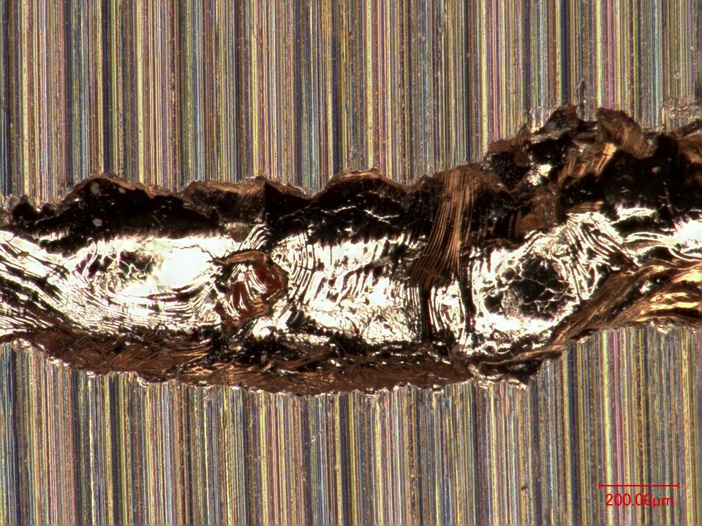
Beam dynamics and beam losses
for circular accelerators
Rüdiger Schmidt, CERN
U.S. Particle Accelerator School January 2017

Slide 2
Programme for the school
What can go wrong?
What are the consequences?
Mitigation
  Are the protection systems efficient and reliable?
Controls and operation

Slide 3
Overview
Basic description of the particle dynamics
Movement of charged particles in a magnetic field
Magnetic fields and focusing of particle beams
Betatron function and optical parameters
Mechanisms for beam losses in a synchrotron

Slide 4
Principle of a synchrotron
Circular accelerator: re-use of accelerating structure
To accelerate to high energy, the synchrotron was developed
Synchrotrons are the most widespread type of accelerators
The synchrotron is a circular accelerator, the particles make many turns
The magnetic field is increased, and at the same time the particles are accelerated
The particle trajectory is (roughly) constant
RF cavity to accelerate the particles
B
Dipole magnets to bring the beam back to the accelerating structure

Slide 5
Particle movement in homogeneous dipole field
z
s
B
v
B
F
x
Particle
B
Horizontal plane: Two particles with the same energy at the same position, but slightly different initial angles meet after each half-turn.
Particle
A
Nominal path

Slide 6
Particle movement in homogeneous dipole field
Particle A
z
B
Vacuum chamber
s
B
Nominal path
v
F
Particle B
x
Vertical plane: Two particles with slightly different initial angles: the separation increases along the path
Mechanism to keep particle together in aperture is required

Slide 7
Particle movement in homogeneous dipole field
Particle A
z
B
s
B
Nominal path
v
F
Particle B
x
Vertical plane: Two particles with slightly different initial angles: the separation increases along the path
Focusing by an electromagnetic lens: quadrupole magnet

Slide 8
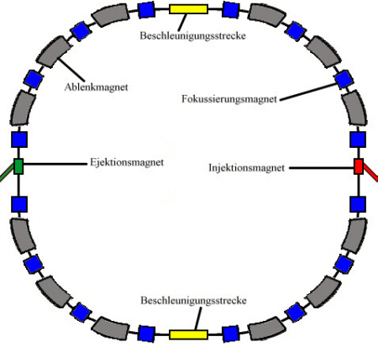
Components of a Synchrotron
Components of a synchrotron:
deflection magnets
magnets to the focus beams
other magnets for beam stability
injection magnets (pulsed)
extraction magnets (pulsed)
acceleration section
vacuum system
diagnosis
control system
power converter
RF cavities
Deflecting magnets
Focusing magnets
Extraction Magnets
Injection Magnets
RF cavities
Circular Accelerator: acceleration in many turns with (a few) RF cavities

Slide 9

What can happen to beams in a circular accelerator?
Assume that the beam is happily circulating in the accelerators: what mechanism can cause beam losses?
Particles are leaving the nominal trajectory (in general around the centre of the vacuum chamber)
Mechanical objects touch the beam (beam instrument, vacuum valve)
Vacuum chamber
beam

Slide 10
Basic beam dynamics

Slide 11
Deflection by quadrupole magnets
Assume that a particle with positive charge is moving into the screen
z
z
View along particle
trajectory
x
x
x
View from above:
defocusing
z
Side view:
focusing
s
s

Slide 12
Quadrupole magnets and focusing
Horizontal Plane
Vertical Plane

Slide 13
Quadrupole magnets and focusing
Horizontal Plane
d = 50 m
Vertical Plane

Slide 14
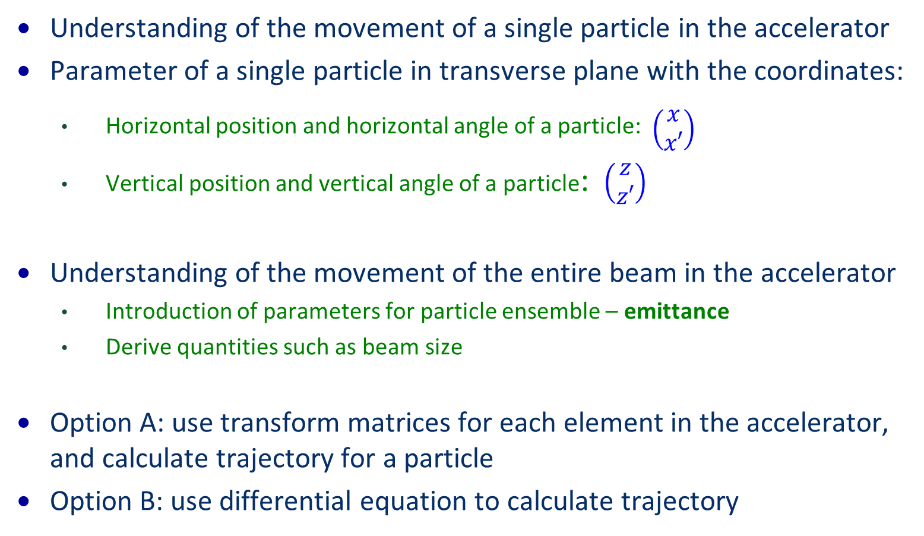
How to understand beam dynamics in a synchrotron?
Understanding of the movement of a single particle in the accelerator
Parameter of a single particle in transverse plane with the coordinates:
  Horizontal position and horizontal angle of a particle: $\begin{matrix} \\ \left(\begin{matrix}x \\ x′\end{matrix}\right)\end{matrix}$
  Vertical position and vertical angle of a particle: $\left(\begin{matrix}z \\ z′\end{matrix}\right)$
Understanding of the movement of the entire beam in the accelerator
  Introduction of parameters for particle ensemble – emittance
  Derive quantities such as beam size
Option A: use transform matrices for each element in the accelerator, and calculate trajectory for a particle
Option B: use differential equation to calculate trajectory

Slide 15
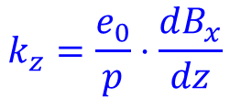
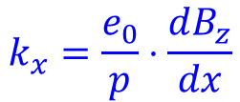
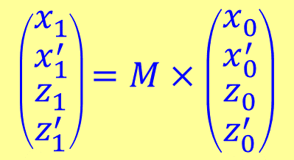
Transport matrices for particle coordinates
Drift with length L
Defocusing Quadrupol with strength k and length s
Focusing Quadrupol with strength k and length s
$$\left(\begin{matrix}x_{1} \\ \begin{matrix}x_{1}^{′} \\ \begin{matrix}z_{1} \\ z_{1}^{′}\end{matrix}\end{matrix}\end{matrix}\right)=M×\left(\begin{matrix}x_{0} \\ \begin{matrix}x_{0}^{′} \\ \begin{matrix}z_{0} \\ z_{0}^{′}\end{matrix}\end{matrix}\end{matrix}\right)$$
$$k_{x}=\frac{e_{0}}{p}⋅\frac{dB_{z}}{dx}$$
$$k_{z}=\frac{e_{0}}{p}⋅\frac{dB_{x}}{dz}$$
15

Slide 16
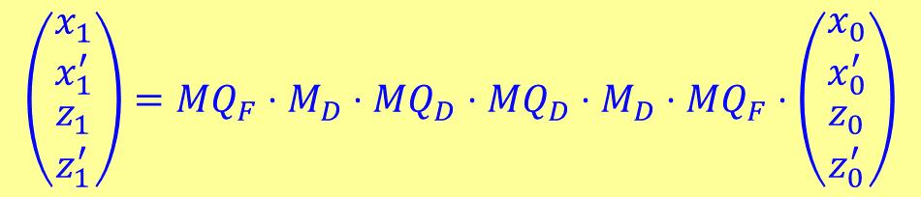
F0D0 cell
QF
horizontal focusing
Dipol
QD
Dipol
QF
F0D0 Zelle
$$\left(\begin{matrix}x_{1} \\ \begin{matrix}x_{1}^{′} \\ \begin{matrix}z_{1} \\ z_{1}^{′}\end{matrix}\end{matrix}\end{matrix}\right)=MQ_{F}⋅M_{D}⋅MQ_{D}⋅MQ_{D}⋅M_{D}⋅MQ_{F}⋅\left(\begin{matrix}x_{0} \\ \begin{matrix}x_{0}^{′} \\ \begin{matrix}z_{0} \\ z_{0}^{′}\end{matrix}\end{matrix}\end{matrix}\right)$$
k(s)
MQ_{F}
M_{D}
MQ_{D}
MQ_{D}
M_{D}
MQ_{F}

Slide 17
Quadrupole and Dipole kicks
Nominal trajectory (ideal orbit = closed orbit)
Distorted trajectory due to wrong quadrupole position
Closed orbit
It is possible to show that there is one particle moving around the accelerators on a closed trajectory – closed orbit

Slide 18
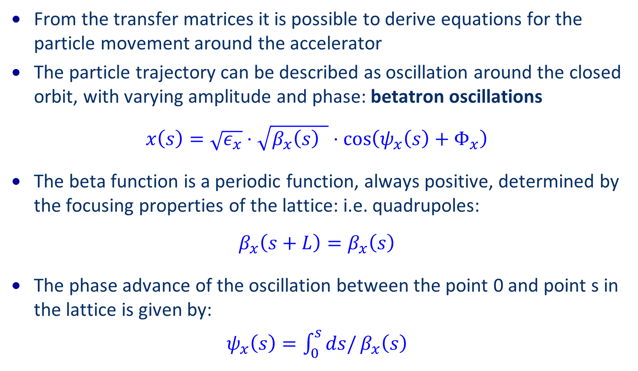
Betatron function and betatron oscillations
From the transfer matrices it is possible to derive equations for the particle movement around the accelerator
The particle trajectory can be described as oscillation around the closed orbit, with varying amplitude and phase: betatron oscillations
$$x\left(s\right)=\sqrt{ε_{x}}⋅\sqrt{β_{x}\left(s\right) }⋅\cos\left(ψ_{x}\left(s\right)+Φ_{x}\right)$$
The beta function is a periodic function, always positive, determined by the focusing properties of the lattice: i.e. quadrupoles:
$$β_{x}\left(s+L\right)=β_{x}\left(s\right)$$
The phase advance of the oscillation between the point 0 and point s in the lattice is given by:
$ψ_{x}\left(s\right)=\int_{0}^{s}{ds/}β_{x}\left(s\right)$

Slide 19
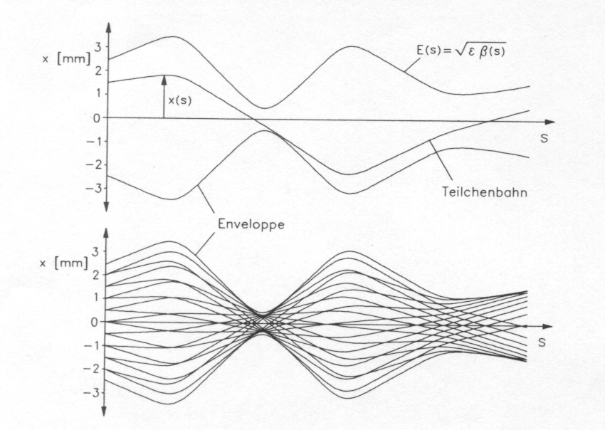
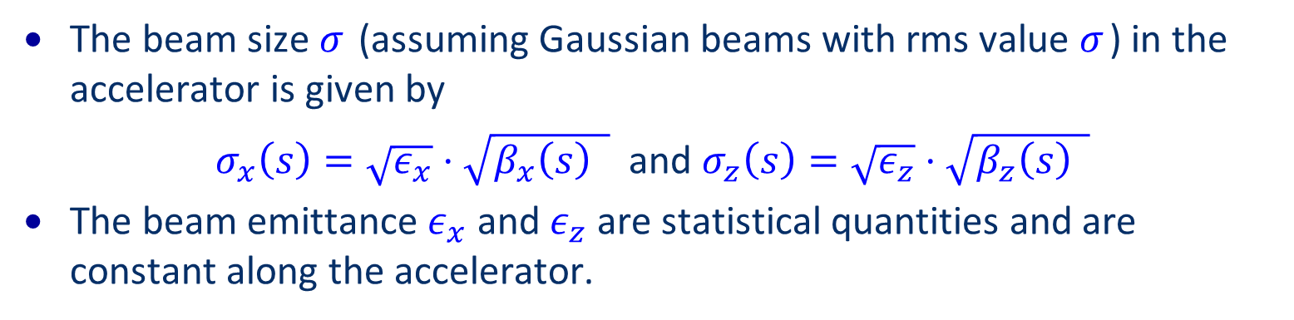
Betatron trajectories and beam size
The beam size $σ_{ }$ (assuming Gaussian beams with rms value $σ_{ }$) in the accelerator is given by
$σ_{x}\left(s\right)=\sqrt{ε_{x}}⋅\sqrt{β_{x}\left(s\right) }$ and $σ_{z}\left(s\right)=\sqrt{ε_{z}}⋅\sqrt{β_{z}\left(s\right) }$
The beam emittance $ε_{x}$ and $ε_{z}$ are statistical quantities and are constant along the accelerator.
Particle trajectories
K.Wille

Slide 20
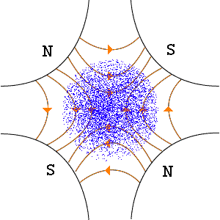
Visualisation

Slide 21
Phase space
Assume that position and angle of each particle at one position in the ring is measured and displayed - Phase Space
Phase space can be round or ellipse, but area is in general conserved
X’
X’
Not the vacuum chamber
X
X

Slide 22
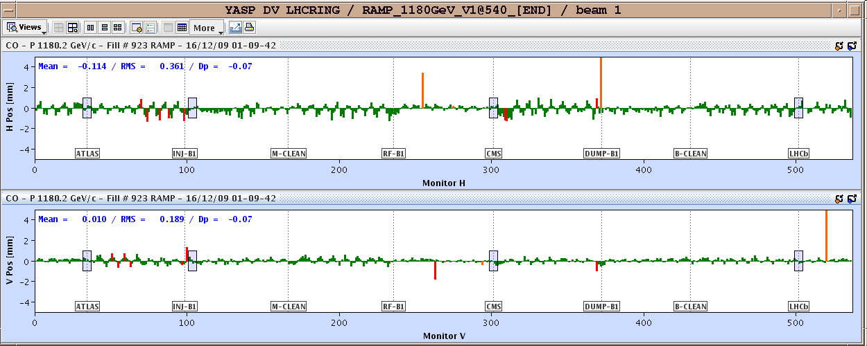
Closed orbit measurement at LHC

Slide 23
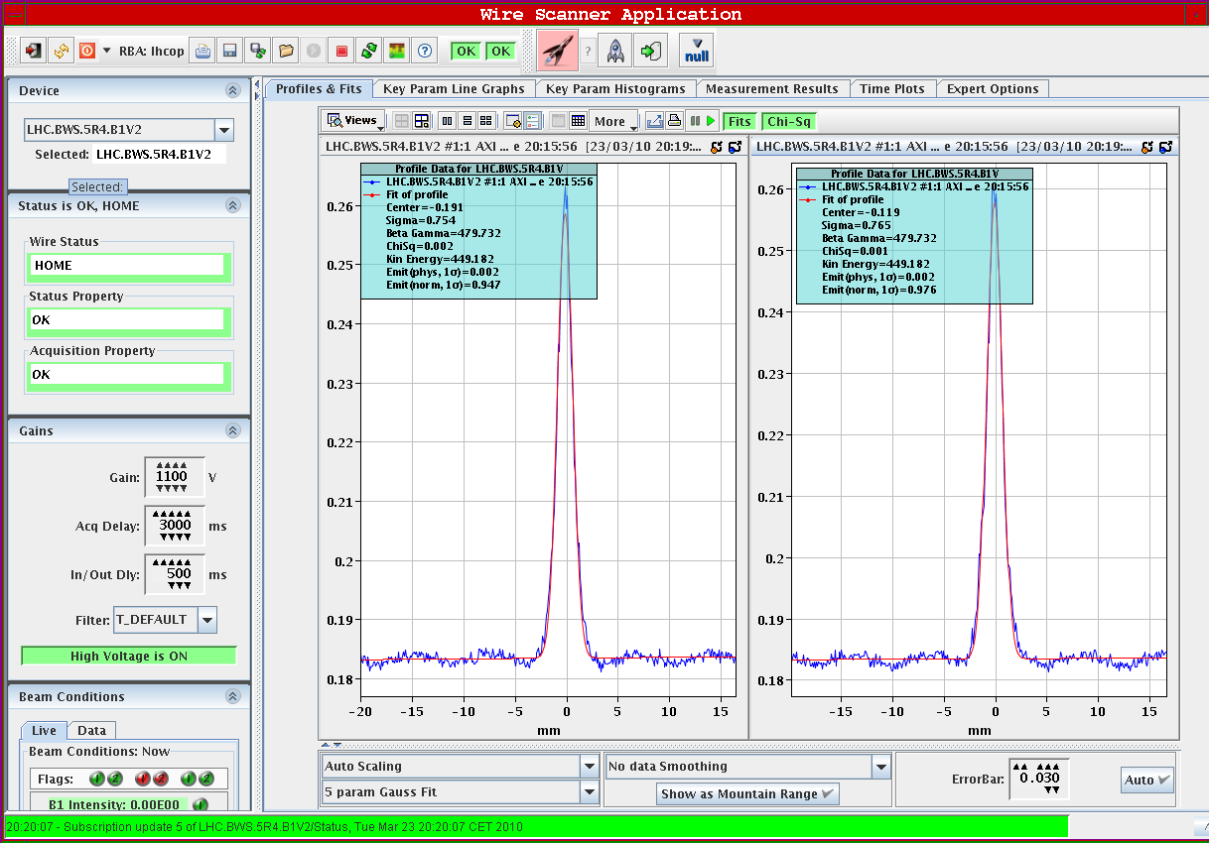
Typical beam profile
Typical beam profiles are close to Gaussian, here measured with a wire scanner (example for LHC)

Slide 24
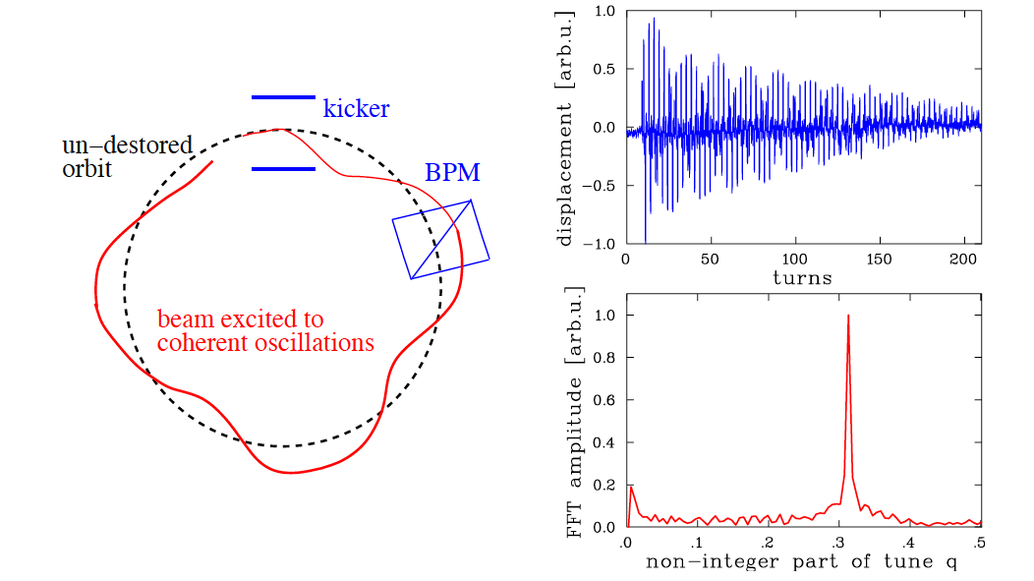
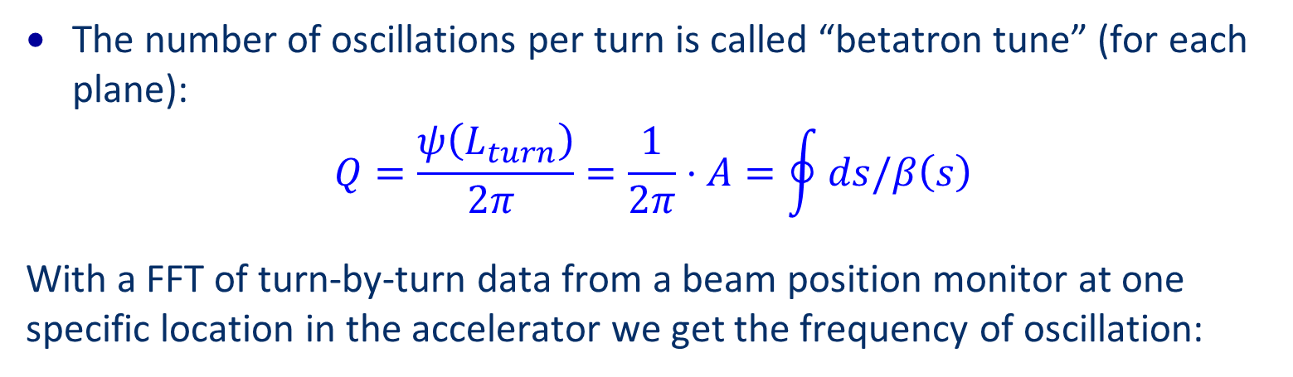
Betatron tune
The number of oscillations per turn is called “betatron tune” (for each plane):
$$Q=\frac{ψ\left(L_{turn}\right)}{2π }=\frac{1}{2π}⋅A=\oint{ds/β\left(s\right)}$$
With a FFT of turn-by-turn data from a beam position monitor at one specific location in the accelerator we get the frequency of oscillation:

Slide 25
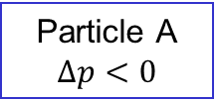
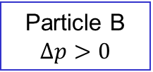
Chromaticity
The betatron tune depends on the momentum of an individual particle
Particles with different momentum are deflected differently
Particle B $Δp>0$
Particle A $Δp<0$
Particle with nominal momentum p
Particles with a momentum deviation have a different betatron tune
This is partially corrected by so-called sextupole magnets
Still, there is some tune spread for different particles in a beam (due to several effects)

Slide 26
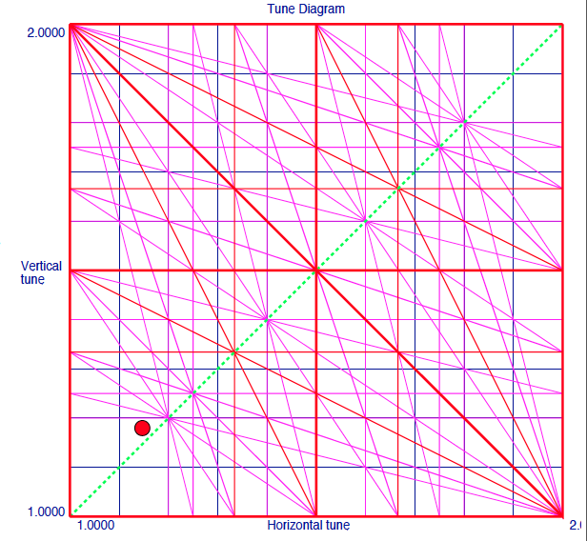
Betatron tune diagram
Particles with integer, half-integer or third integer tunes risk to be lost
Due to the chromaticity and energy spread particles have a different tune
There are other effects that lead to a tune spread (beam-beam, nonlinear fields, effects due to high beam intensity)

Slide 27
Beam loss mechanism
What is required for beams not touching the aperture:
  No mechanical elements in the beam pipe
  Well corrected closed orbit
  Correct betatron tunes
  Correct chromaticity (in general, tune spread limited between resonances)
  Beam intensity below threshold for instabilities
What can go wrong:
  Some mechanical element accidently moves into the vacuum pipe
  Horizontal or vertical dipole magnet has wrong field
  Quadrupole magnet has wrong field
  Sextupole magnets have wrong field – losses due to single particle effects or instabilities
  Too high beam current for the operational point – losses due to single particle effect or instabilities

Slide 28
Why does it go wrong?
For a cycle in an accelerator such as LHC, there are several million parameters used during the acceleration cycle (e.g. current versus time for 1700 power converters).
One single wrong parameter can cause beam losses
Failure of some hardware (power converter)
Single event upset in controller
Thunderstorm (electrical system) affecting powering
Software failure (wrong magnet current programmed)
Operator gives wrong command
Too high beam intensity
Feedback system failure
Wrong timing- functions not synchronised

Slide 29
Quadrupole and Dipole kicks
Nominal trajectory
Distorted trajectory due to wrong quadrupole position
Correction with dipole

Slide 30
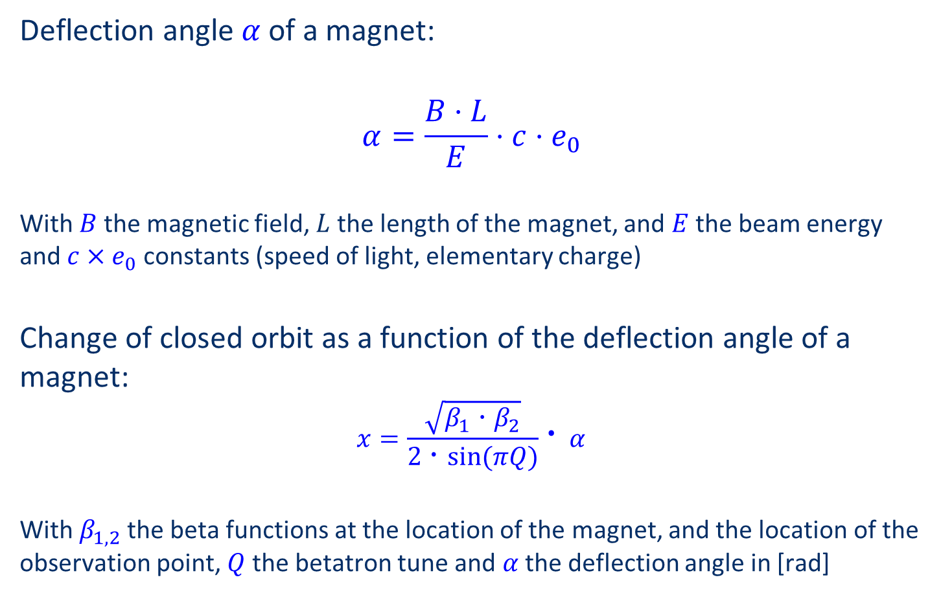
Deflection by a dipole magnet in one plane
Deflection angle $α$of a magnet:
$$α=\frac{B⋅L}{E}⋅c⋅e_{0}$$
With $B$the magnetic field, $L$ the length of the magnet, and $E$the beam energy and $c×e_{0}$ constants (speed of light, elementary charge)
Change of closed orbit as a function of the deflection angle of a magnet:
$$x=\frac{\sqrt{β_{1}⋅β_{2}}}{2⋅sin⁡(πQ)}⋅α$$
With $β_{1,2}$the beta functions at the location of the magnet, and the location of the observation point, $Q$ the betatron tune and $α$the deflection angle in [rad]

Slide 31
Gaussian beam and aperture
99.9% of protons
99.9% of all particles are inside an boundary of 4 σ
Depending on the accelerator and its operational parameters, the aperture can be much larger than 4 σ - but not smaller

Slide 32
Effect of a dipole kick – closed orbit centred
Phase space of particles inside the aperture at a certain location in the accelerator
x’
x

Slide 33
Effect of a dipole kick – closed orbit changes
Phase space of particles inside the aperture – beam move towards aperture boundary
x’
x

Slide 34
Phase space reduction by collimator
Example: the beam moves towards the aperture.
x’
aperture
x
Phase space reduction for circulating beam by collimator (multi-turn effect, different for transfer line or linac!)

Slide 35
Gaussian beam with an aperture at 2.3 σ
92.8% of protons
aperture
Assume that the total energy stored in the beam is 500 MJ (HL-LHC)
Assume a movement to a position with the aperture of 2.3 σ
Assume that all particles above 2.3 σ are lost => corresponds to energy deposition of 35 MJ

Slide 36
Very fast beam loss at LHC

Slide 37
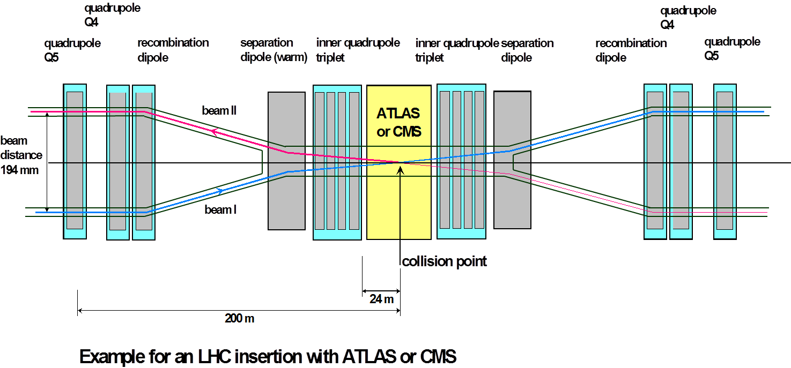
LHC experimental long straight sections and D1
D1
D1
The 2 LHC beams are brought together to collide in a ‘common’ region
Over ~260 m the beams circulate in one vacuum chamber with ‘parasitic’ encounters (when the spacing between bunches is small enough)
D1 separates the two beams

Slide 38
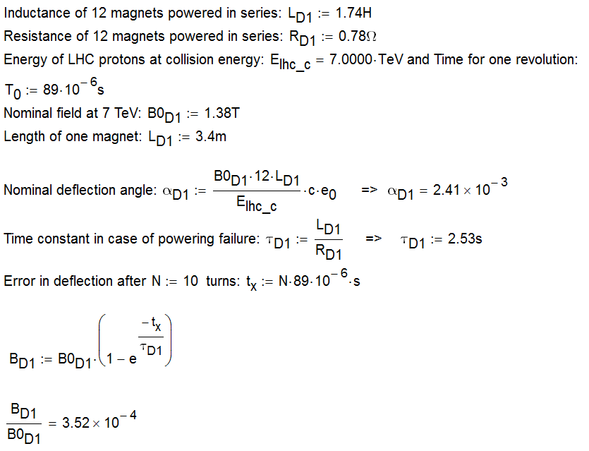
Failure of a D1 magnet at LHC

Slide 39
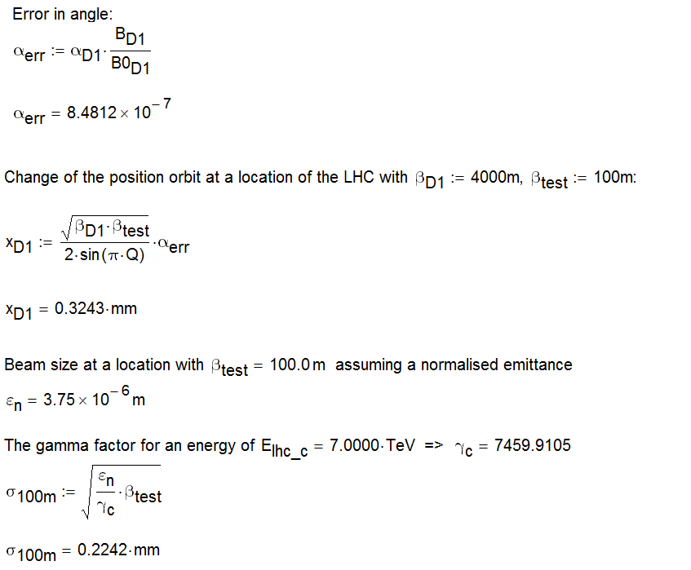
Failure of a D1 magnet at LHC
Beam position change after 0.9 ms, about 1.4 σ

Slide 40
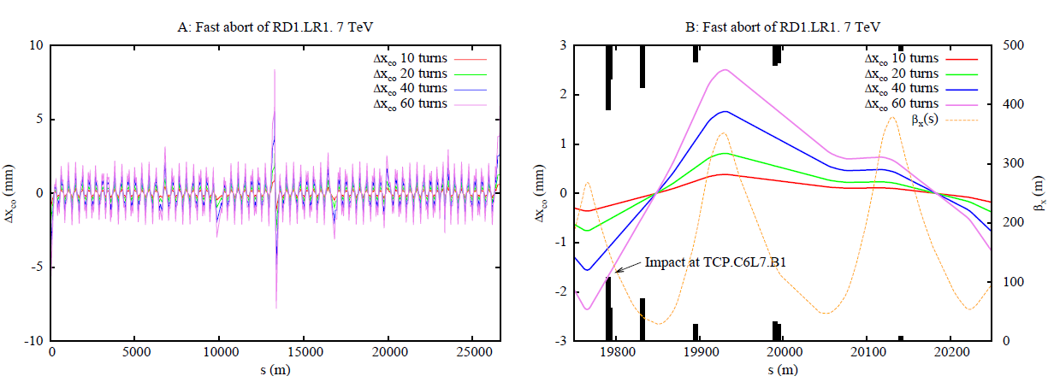
Simulation using MADX of this failure
This failure (and many other failures) were simulated using MADX
A failure of D1 is the most critical failure
Andres Gomez Alonso

Slide 41
Consequences for machine protection
In case of a trip of the D1 magnet the orbit starts to move rather rapidly (1 sigma in about 0.7 ms)
In 10 ms the beam would move by 14 sigma, already outside of the aperture defined by the collimators
For this failure, the beam has to be extracted in a very short time
Probability that this will happen during the lifetime of LHC is high
Detection of the failure by several different systems (diverse redundancy)
  Detection of the failure of a wrong magnet current, challenging, since a fast detection on the level of 10⁻⁴ is required
  Done with a specifically designed electronics (FMCM = Fast Magnet Current Monitor) – M.Werner (DESY) et al.
  Beam loss monitors detect losses when the beam touches the aperture (e.g. collimator jaw, but also elsewhere)
LHC MPS was designed for this type of failure => J.Wenninger

Slide 42
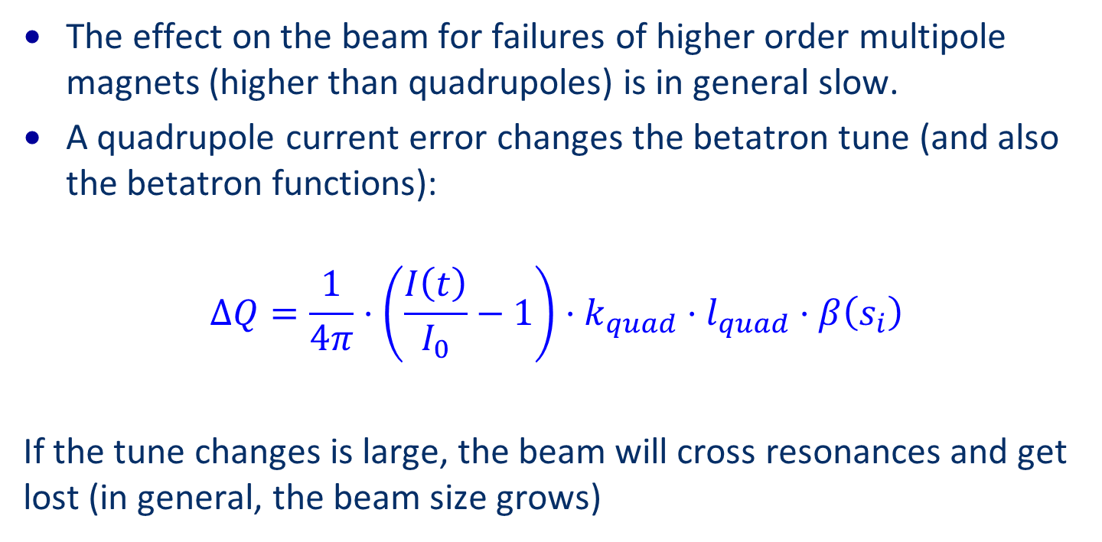
Other type of failures
The effect on the beam for failures of higher order multipole magnets (higher than quadrupoles) is in general slow.
A quadrupole current error changes the betatron tune (and also the betatron functions):
$$ΔQ=\frac{1}{4π}⋅\left(\frac{I\left(t\right)}{I_{0}}−1\right)⋅k_{quad}⋅l_{quad}⋅β\left(s_{i}\right)$$
If the tune changes is large, the beam will cross resonances and get lost (in general, the beam size grows)

Slide 43
Tune diagram and resonances
Particles with integer, half-integer or third integer tunes risk to be lost
Due to the chromaticity and energy spread particles have a different tune
There are other effects that lead to a tune spread (beam-beam, nonlinear fields, effects due to high beam intensity)

Slide 44
Tune diagram and resonances
Particles with integer, half-integer or third integer tunes risk to be lost
Due to the chromaticity and energy spread particles have a different tune
There are other effects that lead to a tune spread (beam-beam, nonlinear field, effects due to high beam intensity)

Slide 45
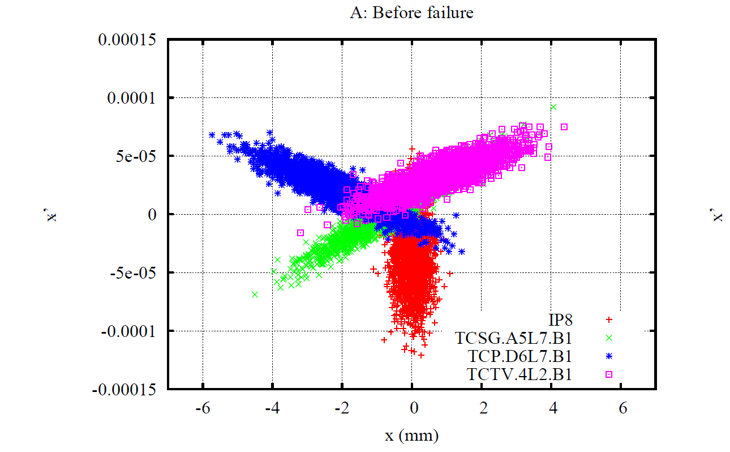
Beam phase space after quadrupole failure

Slide 46
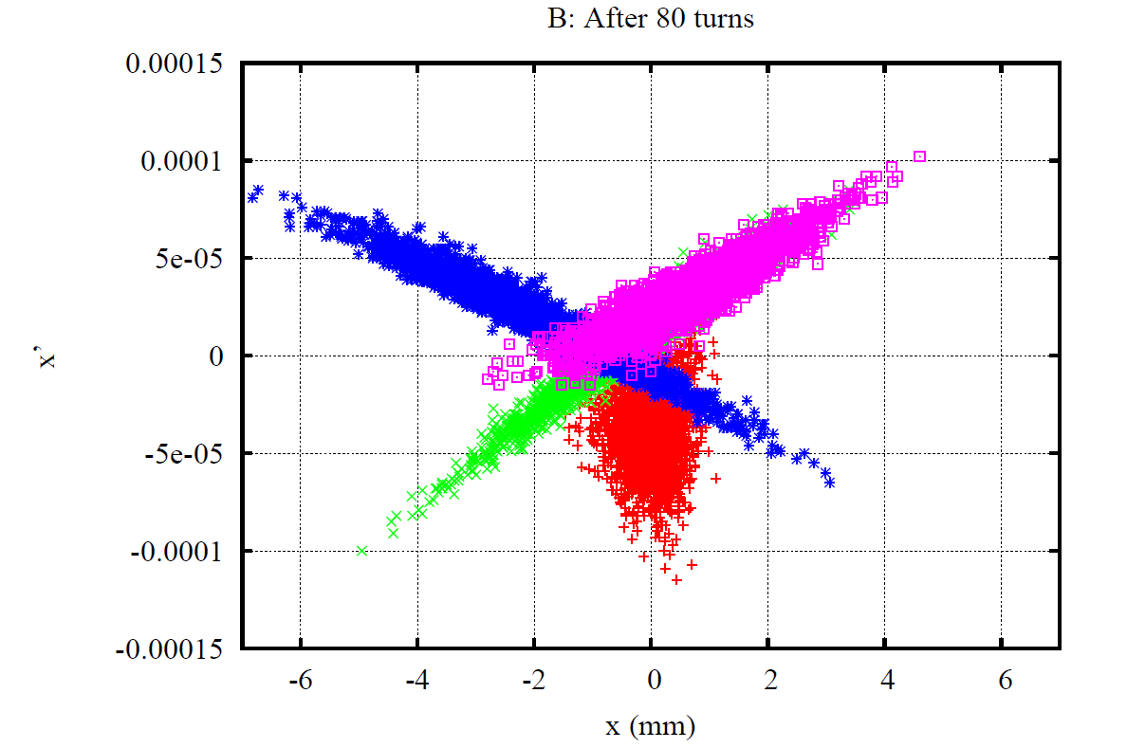
Beam phase space after quadrupole failure

Slide 47

Beam phase space after quadrupole failure

Slide 48
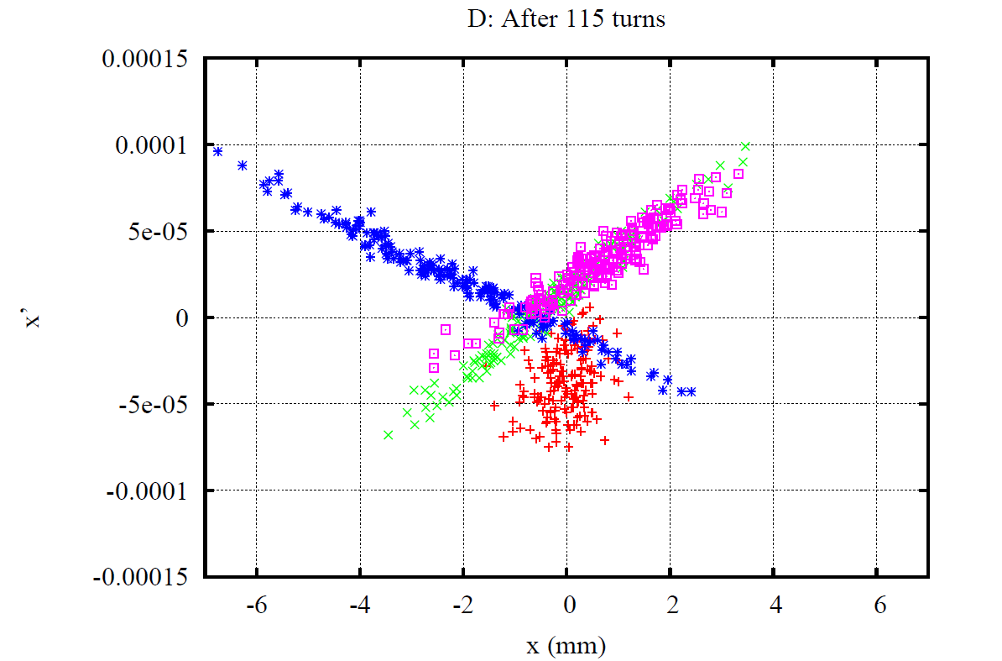
Beam phase space after quadrupole failure

Slide 49
Longitudinal plane: Problems with RF
Why RF for circular accelerators?
Acceleration of the particles
Compensation of energy loss at constant magnetic field
Keeping the particles in a bunch
What happens in case of RF failure? Depends on the operational phase… particles are always lost in the transverse plane (vacuum chamber, collimator, …)
Constant magnetic field
  Protons: beam de-bunches, very slow energy loss
  Electrons: particle losses in short time
Increasing magnetic field
  Particle losses can be rather fast if the RF if off

Slide 50
Beam losses summary
Transverse plane
  Dipole magnets
  Quadrupole magnets
  Other magnets
  Fast kicker magnets
Beam instabilities
  Beam current
  Impedance
Equipment moves into vacuum chamber
  Vacuum valves
  Screens
  Collimators
  Effect on impedance
Longitudinal plane

